Slide 1

NEUROPLASTICITY
Dr Michelle Lussier PT5000

Slide 2
WHAT IS NEUROPLASTICITY?
Neuroplasticity, the brain’s capacity to reorganize itself by forming new neural connections, is central to
modern neuroscience. Once believed to occur only during early development, research now shows that plasticity continues throughout the lifespan, supporting learning, memory, and recovery from injury or disease.

Slide 3
WHAT IS NEUROPLASTICITY?
Definition: The ability of the central nervous system (CNS) to change its structural and functional organization in response to experience, learning, or injury
Mechanisms:
  Synaptogenesis: Creating new connections between neurons to support new
skills.
  Cortical Remapping: Areas of the brain "taking over" functions for damaged
sections.
  Functional Compensation: Using different neuromotor processes to achieve the same action (Motor Equivalence).
Key Principle: "Neurons that fire together, wire together"—repeated, goal-
directed action drives these changes

Slide 4
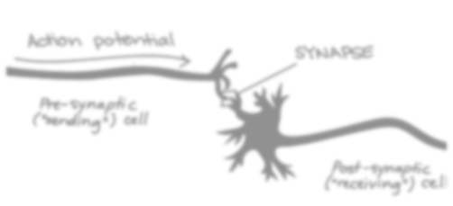
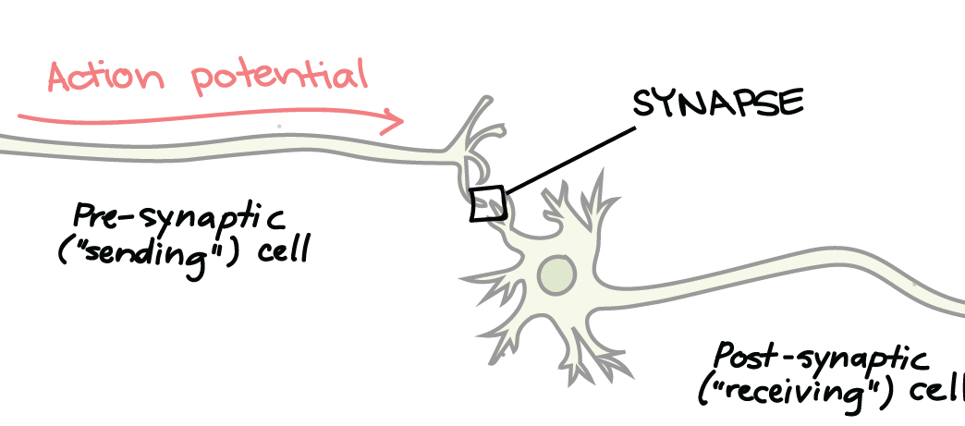

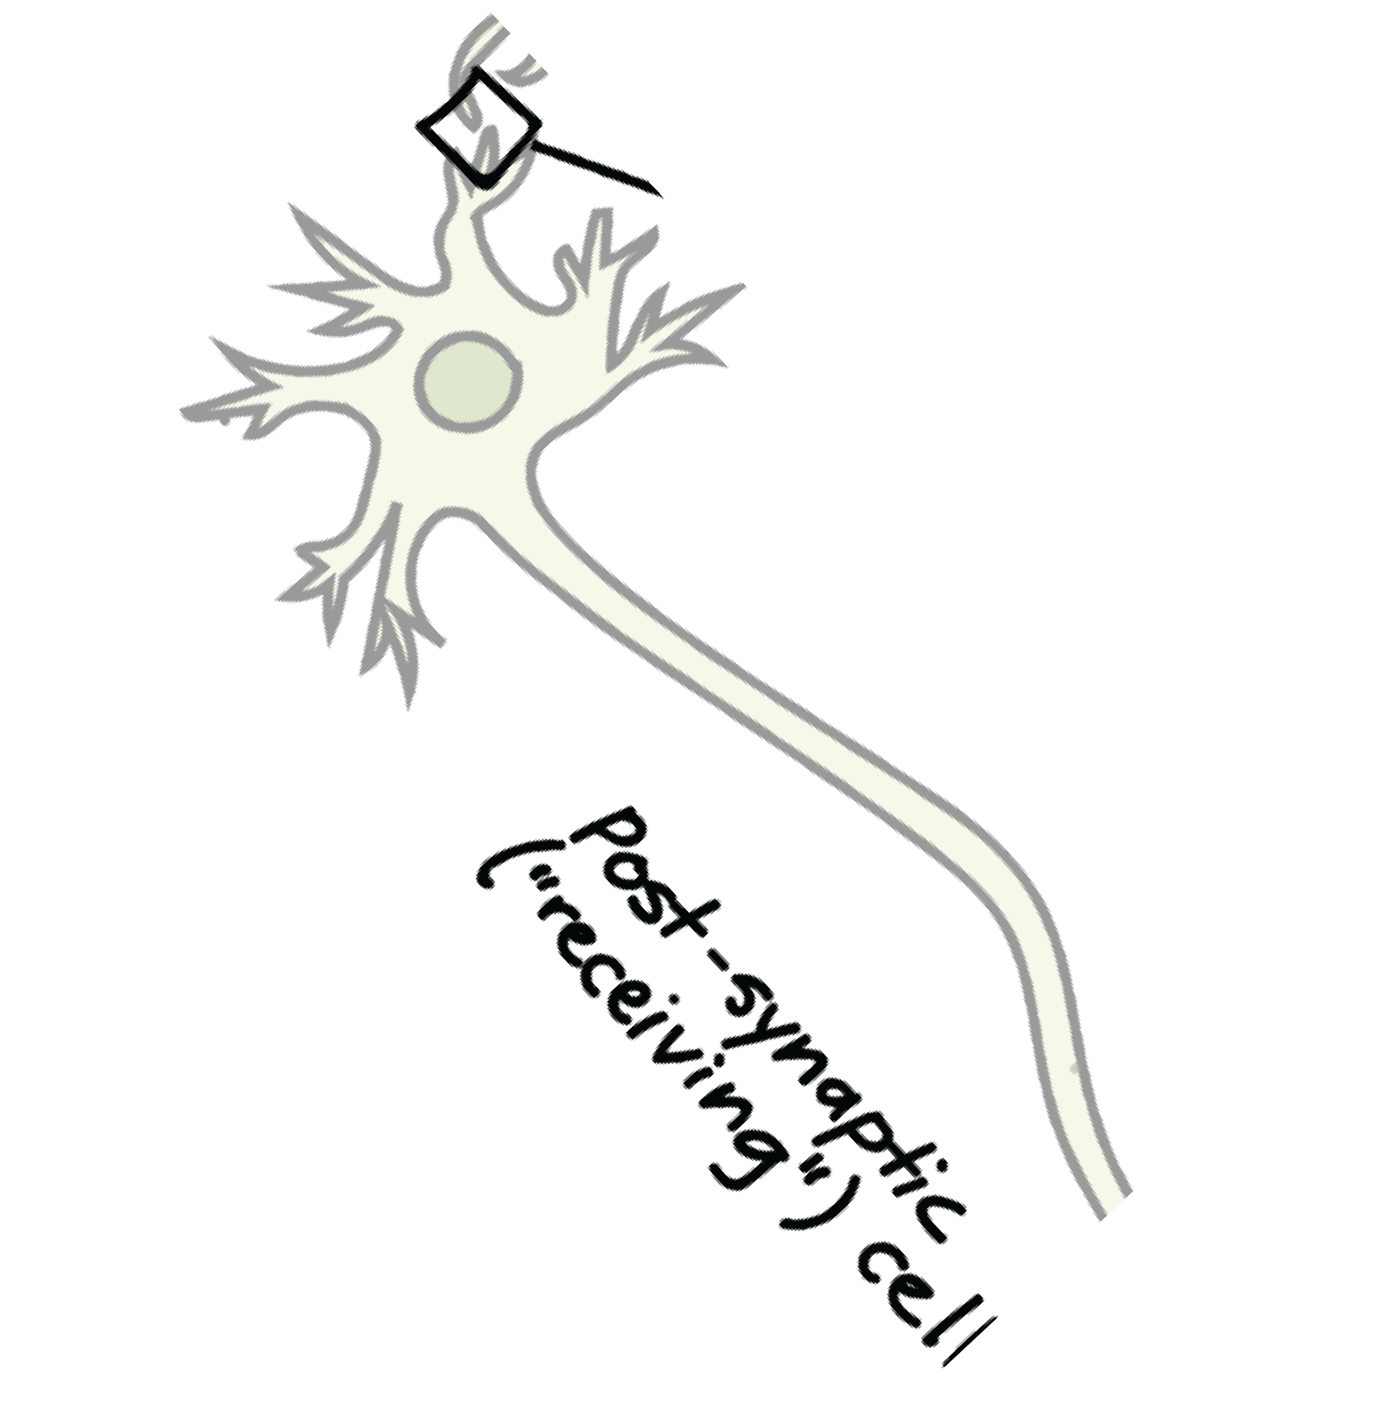
A BIT MORE ON HOW IT HAPPENS (1)
‘’old or damaged cell’’
‘’New pathway made’’
Synaptogenesis
This is the process of forming new synapses between neurons. Think of it as building new roads to connect cities that previously had no direct path.
Clinical Trigger: It is driven by High Intensity Practice and Task Specificity—the brain won't build a "road" it doesn't think you'll use.
The Goal: To move from a temporary "Performance" change to a relatively permanent "Learning" state
This Photo by Unknown Author is licensed under CC BY-SA-NC

Slide 5
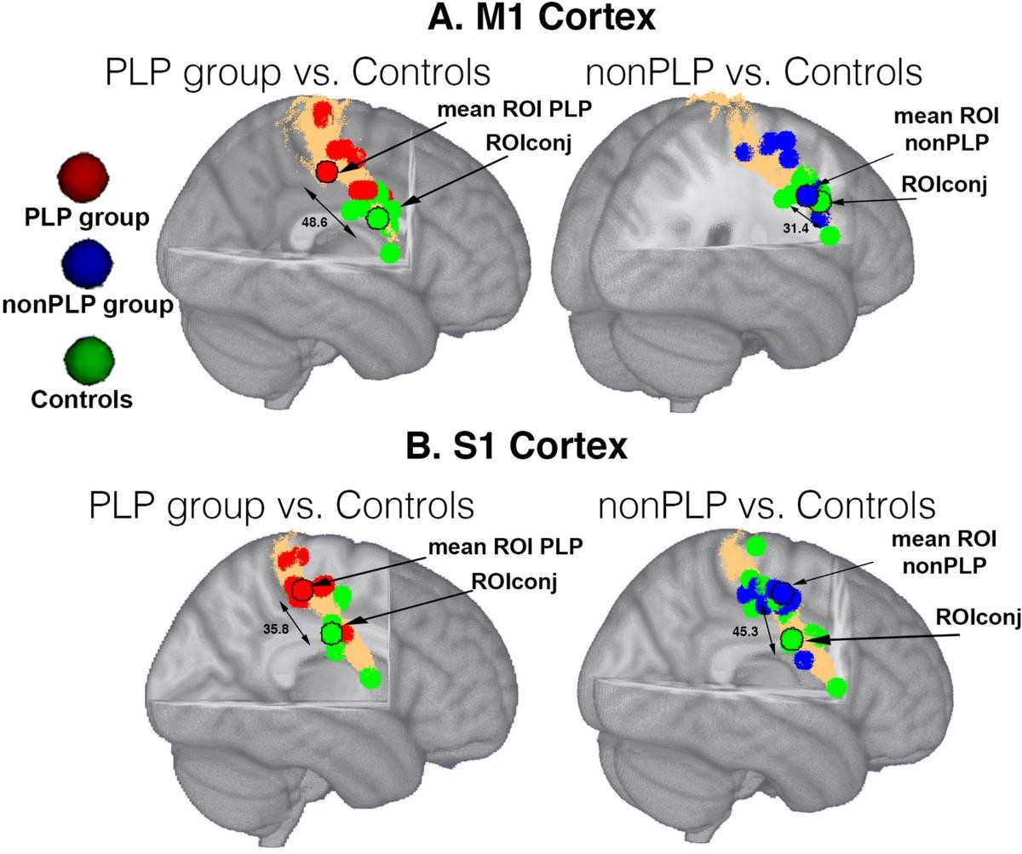
A BIT MORE ON HOW IT HAPPENS (2)
Cortical Remapping
Also known as map expansion or reassignment. If a specific area of the brain is damaged, the surrounding healthy tissue can be "recruited" to take over its duties.
How it works: Through the "Use it or Improve it" principle, the brain rededicates its neural real estate based on which parts are being stimulated by sensory and motor neurons.
Risk: This is a double-edged sword; if a patient stops moving a limb ("Use it or Lose it"), the area of the brain once dedicated to that limb will be "colonized" by other functions.
Picture from: Andoh, J., Milde, C., Diers, M., Bekrater-Bodmann, R., Trojan, J., Fuchs, X., Becker, S., Desch, S. and Flor, H., 2020.
Assessment of cortical reorganization and preserved function in phantom limb pain: a methodological
perspective. Scientific Reports, 10(1), p.11504.

Slide 6
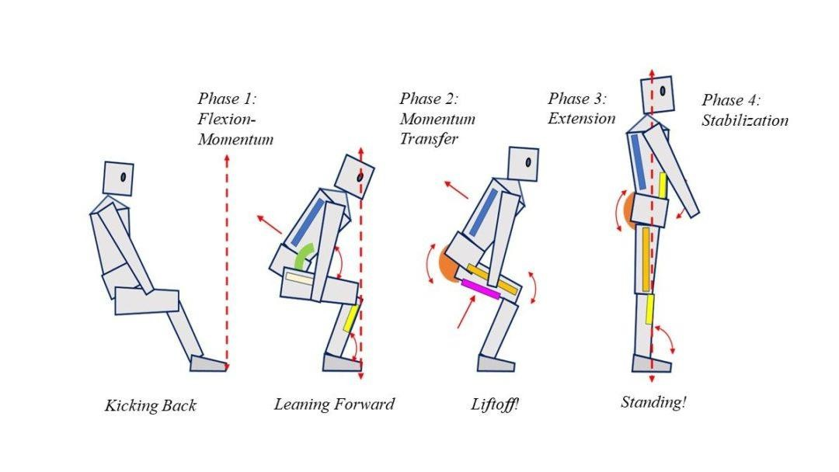
A BIT MORE ON HOW IT HAPPENS (3)
Functional Compensation
This is less about fixing the "broken road" and more about finding a different route to the same destination. In your slides, this aligns perfectly with the concepts of Equivalence.
Movement Equivalence: The patient changes the way they move (biomechanical strategies or patterns) to accomplish the same task.
Motor Equivalence: The patient changes the neuromotor processes (the brain areas or nerves utilized) to produce the same outcome.

Slide 7
WINDOWS OF OPPORTUNITY FOR
PHYSIOS (WHEN)
Maximizing the "Plastic" Brain
Critical & Sensitive Periods: Early development represents a peak "window" where the CNS is highly adaptable to environmental and task demands.
Post-Injury "Spontaneous" Recovery: In the early stages after neurological insult (like stroke or TBI), there is a biological prime time for recovery of function.

Slide 8
WINDOWS OF OPPORTUNITY FOR
PHYSIOS (WHEN)
Pediatric Focus:
  The first 3 years of life represent a peak for neuroplasticity and motor foundation.
  Significant improvements in gross motor function are typically observed up to age
6–7.
  Between ages 7 and 12, this is a prime time for children to acquire complex skills like
swimming, cycling, or gymnastics
  Bone Density Loading: Puberty (approx. ages 10–14). This is a sensitive period for the skeletal system where impact-loading exercises have the greatest lifelong effect on bone mineral density.

Slide 9
WINDOWS OF OPPORTUNITY FOR
PHYSIOS (WHEN)
Adult Focus
  The brain's capacity to rewire itself peaks approximately 2 weeks after a stroke.
  Most "spontaneous" recovery occurs within the first 3 to 6 months, making early,
intensive physiotherapy most effective.
Stroke
  The Hyper-Acute Window (0–48 hours): The brain is in "survival mode." Therapy focuses on preventing further damage and basic investigatory focus.
  The Acute Window (2 days to 2 weeks): This is the peak of Post-Stroke Plasticity. Levels of growth-promoting genes are at their highest. This is the "window of opportunity" where high-intensity practice can drive the most significant cortical remapping.
  The Sub-Acute Window (2 weeks to 3 months): Most "spontaneous" recovery occurs here. After 3 to 6 months, the "window" doesn't close, but the brain enters a "chronic" state where changes require significantly more repetitions (e.g., the 300+ reps mentioned in your slides) to achieve the same result.

Slide 10
WINDOWS OF OPPORTUNITY FOR PHYSIOS
(WHEN)
Condition | Optimal Window for Neuroplasticity | Clinical Goal
Cerebral Palsy (Pediatric) | Birth to 3 years (Primary); up to age 7 (Secondary) | Influence foundational motor control models during critical development.
Stroke (Adult) | 2 days to 3 months (Peak at approx. 2 weeks) | Capitalize on growth-promoting genes for cortical remapping.
Phantom Limb Pain | Acute post-amputation (pre- maladaptive remapping) | Prevent sensory "colonization" of the cortex by neighboring areas.
Traumatic Brain Injury | First 6 months post-injury | Drive synaptogenesis to bypass damaged axonal tracts.
Spinal Cord Injury | First 6 to 12 months | Strengthen spared neural pathways and functional compensation.
Parkinson’s Disease | Continuous/Lifelong (Maintenance focus) | Use "salience-dependent" plasticity to slow functional degradation.
Chronic Pain/CRPS | Prior to 3–6 months (to prevent chronicity) | Re-map the distorted sensory representation in the CNS.

Slide 11
WINDOWS OF OPPORTUNITY FOR
PHYSIOS (HOW)
The Therapist's Role…
High Intensity: Plasticity requires high repetition—e.g., 300 reps for
upper limbs or 2,000 steps for the lower limb.
Challenge: The task must be difficult enough to require new neural
strategies, often involving dual-tasking.
Salience: Activities must be meaningful (e.g., reaching for food) to trigger the cognitive processes essential for motor control.
Use it or Lose it: If the "window" is missed or the limb is not used, the brain area may be taken over by other functions, leading to "learned non-use".

Slide 12
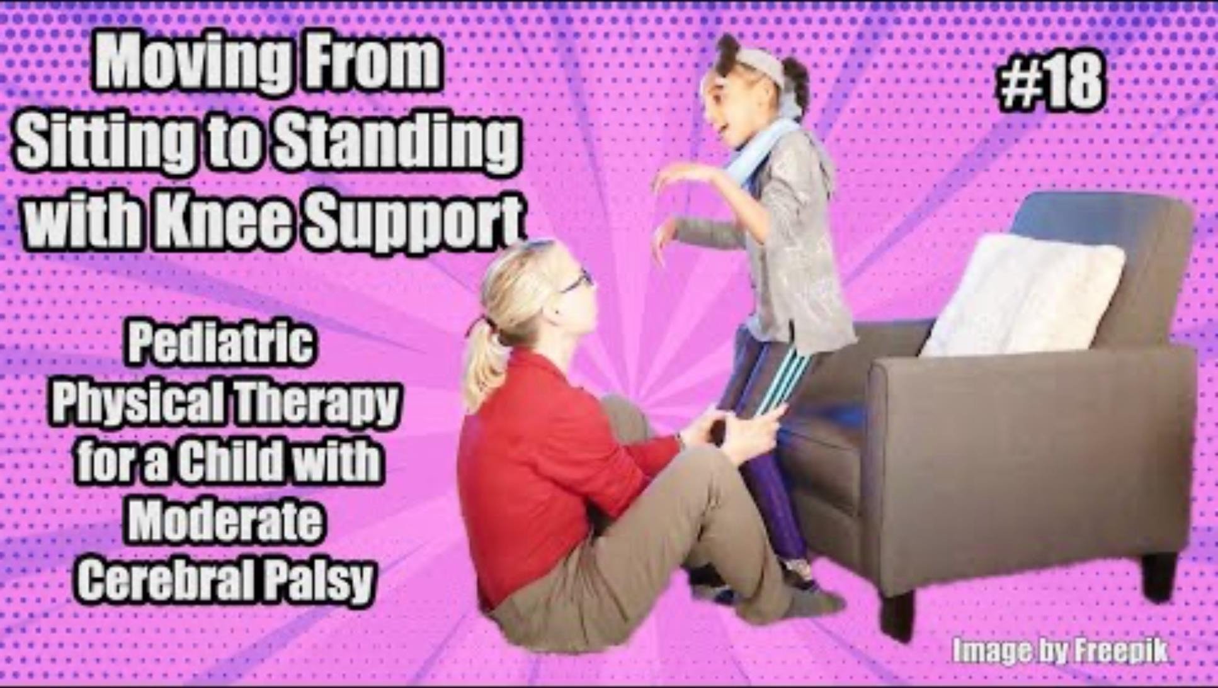
CASE STUDY

Slide 13
CASE STUDY
Variable | Observation from Video
Individual | Spasticity and "dyscontrol" lead to a tendency to lean backward (extensor thrust) rather than forward during the transition.
Task | A sit-to-stand action focused on transitioning from a seated position to standing with minimal assistance at the knees.
Environment | A high-salience setting using a piano as a motivator; the therapist provides traction at the knees to facilitate the "nose over toes" forward weight shift.
Neuroplasticity Focus | Using goal-directed repetition to drive synaptogenesis and move from temporary performance to a permanent, economical skilled action.

Slide 14
CASE STUDY
In the video, Alexis performs approximately three sit-to-stand repetitions. Based on the "High Repetition" requirements for neuroplasticity, how would you structure a 45-minute session to ensure Alexis reaches a dosage that moves her from temporary performance to permanent learning?
• The therapist uses traction at the knees to guide Alexis into a "nose over toes" position. If this task becomes too easy for Alexis, how could you modify the Environmental Constraints (regulatory factors) to increase the challenge and force her CNS to reorganize its stability and mobility patterns?
Why is the use of the piano more effective for driving neuroplasticity than simply asking Alexis to perform "anatomical movements" like leg extensions? Discuss how the investigatory behavior of reaching for the toy helps focus her attention and gather the sensory information needed to select the correct movement.

Slide 15
REFERENCES
Andoh, J. et al. (2020) 'Assessment of cortical reorganization and preserved function in
phantom limb pain: a methodological perspective', Scientific Reports, 10(1),
p. Philadelphia: Wolters Kluwer) 'Evidence for a Window of Enhanced Plasticity inWolters Kluweror Cortex Following Ischemic Stroke', Neurorehabilitation and Neural Repair, 35(4).
Pediatric Physical Therapy Exercises (2023) #18 Moving Sit to Stand with Knee Support: Pediatric PT for a Child with Moderate Cerebral Palsy. 17 September. Available at: https://www.youtube.com/watch?v=5afKQfCD4GE (Accessed: 2 March 2026).
ScienceDirect (2025) 'Neuroplasticity and the evolving brain', Brain Research, 1850. Available at: https://www.sciencedirect.com/science/article/pii/S0006899325002021 (Accessed: 2 March 2026).
Shumway-Cook, A. and Woollacott, M. H. (2023) Motor Control: Translating Research into Clinical Practice. 6th edn. Philadelphia: Wolters Kluwer.

